Slide 1
Frequent Subgraph Mining

Slide 2
When you work with graphs…
First question: What kind of graphs?
Single large networks
Social Networks
Protein-protein interaction networks
Road networks
Graph databases: lots of small graphs
Chemical compound databases
Function call graphs
Webpage visit logs

Slide 3
Applications of Graph Pattern Mining
Identify hidden characteristics of a dataset
What are the commonalities among the actives?
Classification
Active
molecules against HIV virus
Graph Patterns
Frequent Subgraph Mining
Indexing

Slide 4
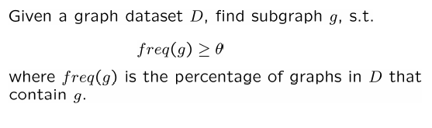
What are graph patterns?
Given a function f(g) and a threshold θ, find all subgraphs g, such that f(g) ≥ θ.
Example: frequent subgraph mining.

Slide 5
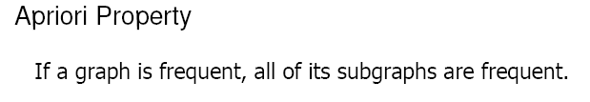
c
c
a
b
e
a
a
b
c
e
d
d
a
b
d
f
f
f
d
G₁
G₂
G₃
G₄
c
a
b
Is this the only frequent subgraph?
Θ=75%
d
NO!
Frequent subgraph
Notes:
As you will see later, this is a central property in all techniques that mine frequent subgraphs. As we move from frequent to other mining functions, the problem gets harder since the property cannot be utilized to prune candidates

Slide 6
Why is graph mining hard?
If a graph is frequent, all of its subgraphs are frequent ─ the Apriori property
Worst Case: An n-edge frequent graph may have 2^{n} subgraphs.
Among 422 chemical compounds that are confirmed to be active in an AIDS antiviral screen dataset, there are ~1,000,000 frequent graph patterns if the minimum support is 5%.

Slide 7
Frequent Subgraph Mining
Join Based Approach
Pattern Growth Approach
gSpan
Inokuchi et al.
PATH
MoFa
FFSM
FSG
Gaston
PKDD, 00
ICDM, 01
ICDM, 02
ICDM, 02
ICDM, 02
ICDM, 03
KDD, 04
Notes:
Inokuchi et al. : first apriori approach. Each candidate has one more node.
FSG: Apriori approach. Grow from k to k+1
MoFA (Borgelth and Berthold from Germany): pattern growth approach, but without any good pruning techniques. First to introduce storing of embedding information.
PATH: first find all frequent paths, and then join paths to grow.
gSpan: DFS code, depth first approach
FFSM: improvement over FSG, stores embedding information.
Gaston: improvement over gspan by growing paths, trees, and cycles separately. Also stores embedding information.

Slide 8
Graph mining methods
Join-based approach (Breadth-first)
Pattern-growth approach (Depth-first)

Slide 9
Join-Based Approach
(k+1)-edge subgraphs
k-edge subgraphs
g₁
g
g₂
g’
…
g’’
g_{n}
join

Slide 10
Pattern Growth Method
(k+2)-edge subgraphs
(k+1)-edge subgraphs
g₁
…
k-edge subgraphs
g₂
g
…
g_{n}
…
Notes:
Apriori:
Step1: Join two k-1 edge graphs (these two graphs share a same k-2 edge subgraph) to generate a k-edge graph
Step2: Join the tid-list of these two k-1 edge graphs, then see whether its count is larger than the minimum support
Step3: Check all k-1 subgraph of this k-edge graph to see whether all of them are frequent
Step4: After G successfully pass Step1-3, do support computation of G in the graph dataset, See whether it is really frequent.
gSpan:
Step1: Right-most extend a k-1 edge graph to several k edge graphs.
Step2: Enumerate the occurrence of this k-1 edge graph in the graph dataset, meanwhile, counting these k edge graphs.
Step3: Output those k edge graphs whose support is larger than the minimum support.
Pros:
1: gSpan avoid the costly candidate generation and testing some infrequent subgraphs.
2: No complicated graph operations, like joining two graphs and calculating its k-1 subgraphs.
3. gSpan is very simple
The key is how to do right most extension efficiently in graph. We invented DFS code for graph.

Slide 11
FSG Algorithm (http://glaros.dtc.umn.edu/gkhome/fetch/papers/fsgTKDE04.pdf) [M. Kuramochi and G. Karypis. Frequent subgraph discovery. ICDM 2001]
Notation: k-subgraph is a subgraph with k edges.
Init: Scan the transactions to find F₁, the set of all frequent
1-subgraphs and 2-subgraphs, together with their counts;
For (k=3; F_{k-1} ≠ ∅ ; k++)
Candidate Generation - C_{k}, the set of candidate k-subgraphs, from F_{k-1}, the set of frequent (k-1)-subgraphs;
Candidates pruning - a necessary condition of candidate to be frequent is that each of its (k-1)-subgraphs is frequent.
Frequency counting - Scan the transactions to count the occurrences of subgraphs in C_{k};
F_{k} = { c ∈C_{K} | c has counts no less than #minSup }
Return F₁ ∪ F₂ ∪ ……∪ F_{k} (= F )

Slide 12
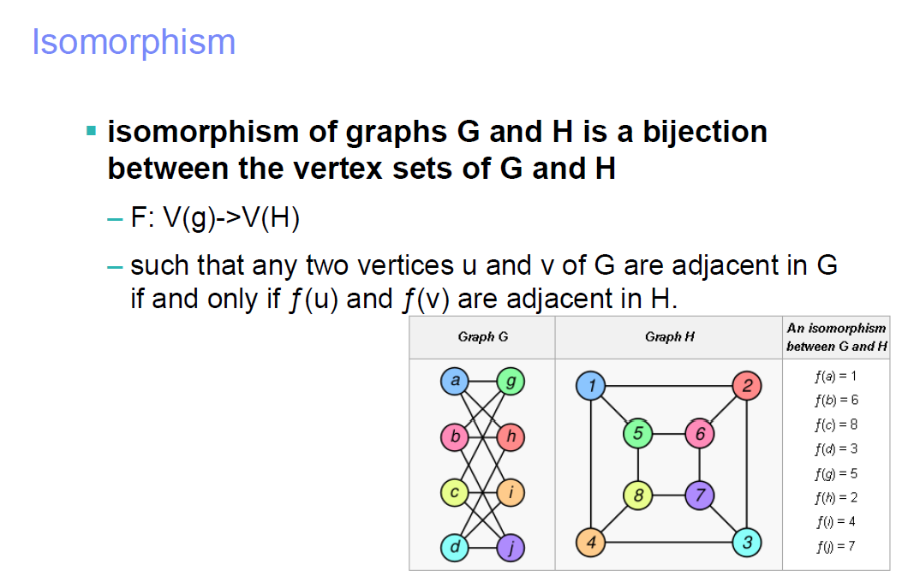

Slide 13
FSG: Candidate Generation - I
Join two frequent size-k subgraphs to get (k+1) candidate
Core subgraph: Common connected subgraph of size (k-1) necessary

Slide 14
Candidates generation (join) based on core detection
+
Same as joining itemsets…

Slide 15
Candidates generation (join) based on core detection
+

Slide 16
+
If you join an itemset S with S itself, you will get S again. Is this true in graphs?
This results from core automorphism: multiple interpretations of the same core due to symmetry

Slide 17
Core automorphism
+

Slide 18
What is the core?
Multiple cores between two (k-1)-subgraphs

Slide 19
Candidate Generation
Core Subgraph identification from frequent k-subgraphs
Generate each possible subgraph of both graphs g₁ and g₂
Do O(k²) computations to identify the isomorphic cores
Join to generate new (k+1)-subgraph candidates
Prune candidates using apriori
Check if all k-subgraphs are frequent
Graph isomorphism
Then check actual frequency
Subgraph Isomorphism
Canonical labeling

Slide 20
Canonical labelling
Convert a graph to a string such that two graphs are isomorphic iff their canonical labels are identical
Complexity of constructing canonical labels?

Slide 21
Canonical label of graph
Lexicographically largest (or smallest) string obtained by concatenating upper triangular entries of adj. matrix (after symmetric permutation)
Is this scalable?
O(|V|!)

Slide 22
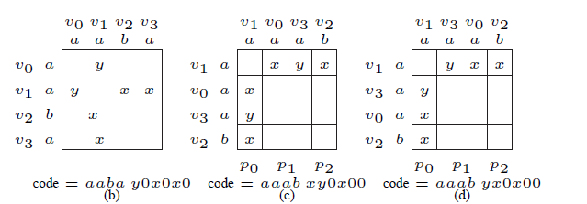
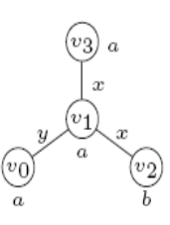
Canonical labeling
Number of Combinations:= 2!*1!*1! =2 instead of 4!=24.

Slide 23
FSG: canonical labeling based on a heuristic
Vertex invariants
Inherent properties of vertices that don’t change across isomorphic mappings
E.g. degree or label of a vertex
Use vertex invariants to partition vertices of a graph into equivalent classes
If vertex invariants cause m partitions of V containing p₁, p₂, …, p_{m} vertices respectively, then the number of different permutations for canonical labeling
π (p_{i} !) ; i = 1, 2, …, m
which can be significantly smaller than |V| ! permutations

Slide 24
Canonical labeling possibilities through partitioning
In other words, vertex invariants are like hash codes
Less the number of collisions, better is the partitioning performance
Can you think of other better vertex invariants with respect to graph isomorphism?

Slide 25
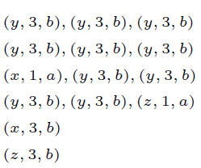
FSG canonical label: vertex invariant - II
Partition based on neighbor lists
Describe each adjacent vertex by a tuple < l_{e}, d_{v}, l_{v} >
l_{e} = edge label
d_{v} = degree
l_{v} = label
Two vertices in same partition iff their nbr. lists are same

Slide 26
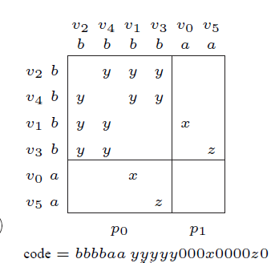
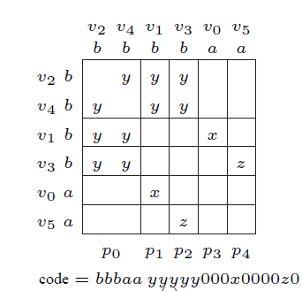
FSG canonical label: vertex invariant - II
Example: only 2! Permutations instead of 4! x 2!

Slide 27
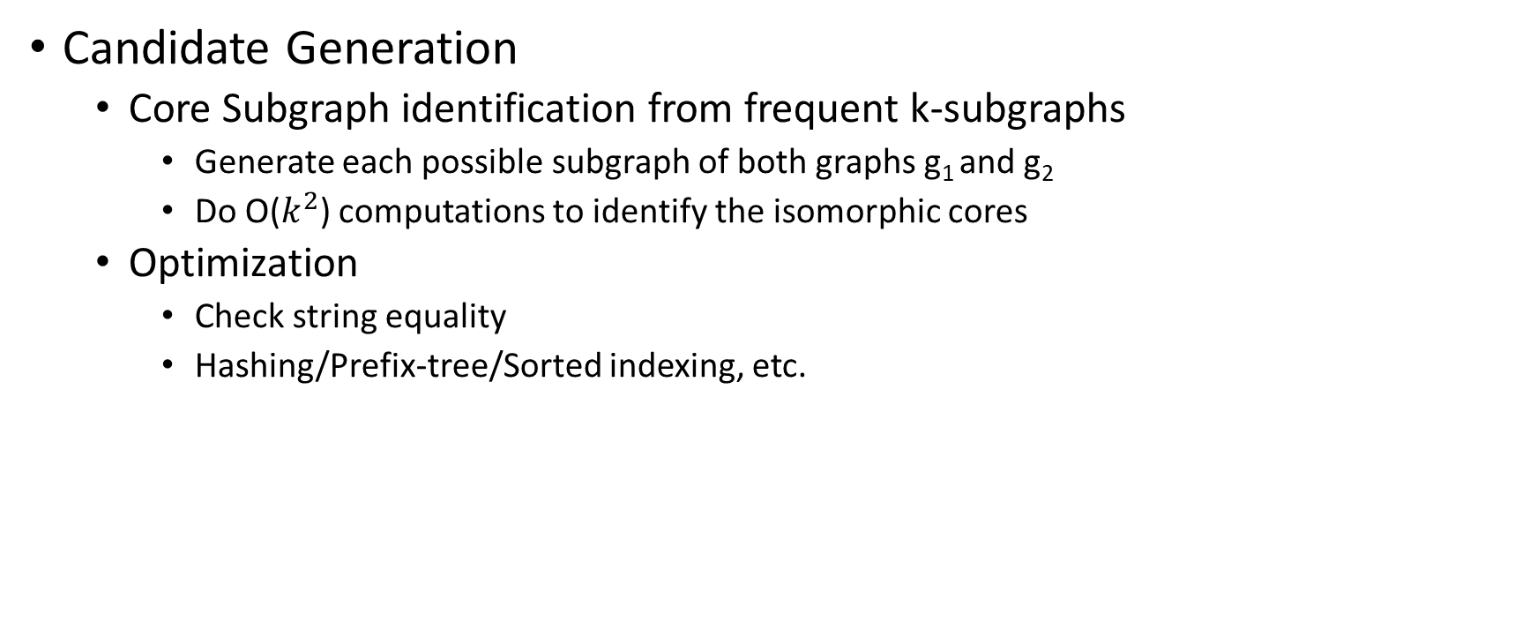
Using canonical labels for optimizations
Candidate Generation
Core Subgraph identification from frequent k-subgraphs
Generate each possible subgraph of both graphs g₁ and g₂
Do O($k^{2}$) computations to identify the isomorphic cores
Optimization
Check string equality
Hashing/Prefix-tree/Sorted indexing, etc.

Slide 28
Using canonical labels for optimizations
Join to produce k+1-subgraph candidates
Pruning candidates based on apriori
Naïve approach
Generate all possible subgraphs
Perform graph isomorphism for each subgraph against all frequent k-subgraphs
Optimization
Just string matching

Slide 29
FSG: Frequency Counting
Naïve way
Subgraph isomorphism check for each candidate against each graph transaction in database
Computationally expensive and prohibitive for large datasets
Can we do better?

Slide 30
Another FSG Heuristic: frequency counting
Transactions
g^{k-1}₁ , g^{k-1}₂ ⊂ T1
g^{k-1}₁ ⊂ T2
g^{k-1}₁ , g^{k-1}₂ ⊂ T3
g^{k-1}₂ ⊂ T6
g^{k-1}₁ ⊂ T8
g^{k-1}₁ , g^{k-1}₂ ⊂ T9
Frequent subgraphs
TID(g^{k-1}₁) = { 1, 2, 3, 8, 9 }
TID(g^{k-1}₂) = { 1, 3, 6, 9 }
Candidate
c^{k} = join(g^{k-1}₁, g^{k-1}₂)
TID(c^{k}) ⊂ TID(g^{k-1}₁) ∩ TID(g^{k-1}₂)
⇓
TID(c^{k} ) ⊂ { 1, 3, 9}
Perform subgraph-iso to T1, T3 and T9 with c^{k} and determine TID(c^{k})

Slide 31
FSG performance on DTP Dataset (chemical compounds)

Slide 32
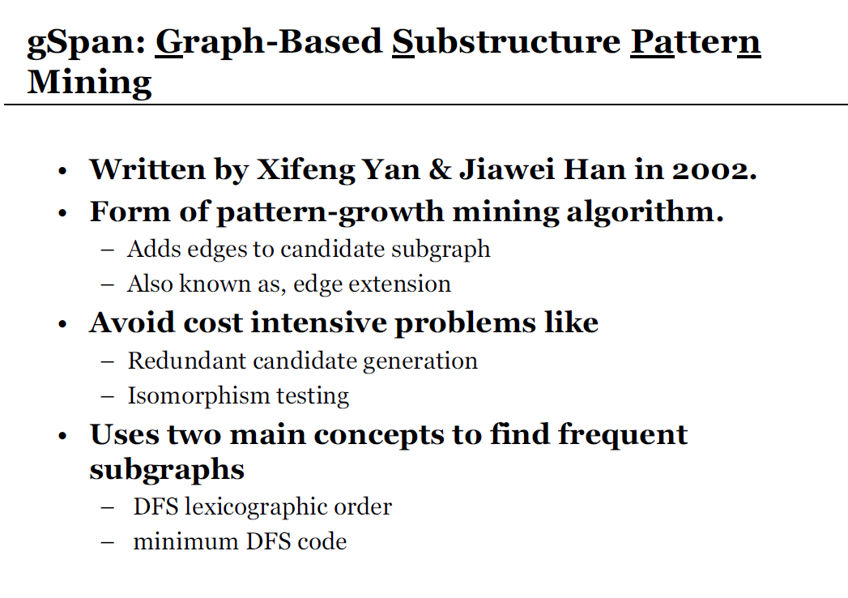
For more detailed information, read the technical report version
http://www.cs.ucsb.edu/~xyan/papers/gSpan.pdf

Slide 33
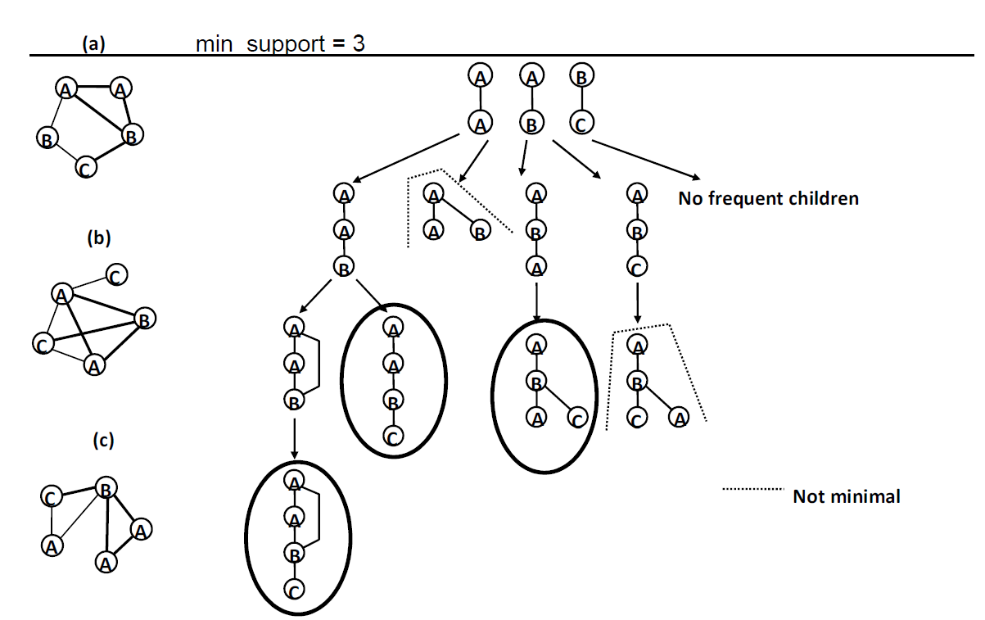
gSpan

Slide 34
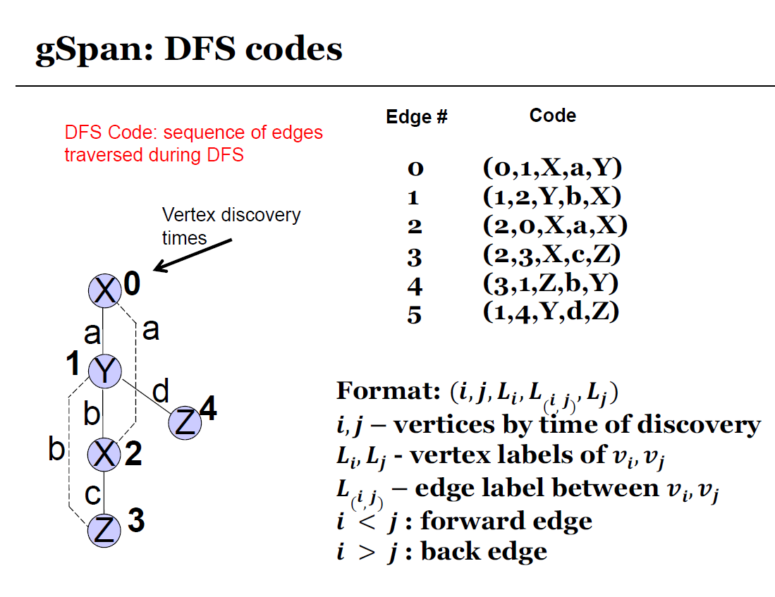

Slide 35
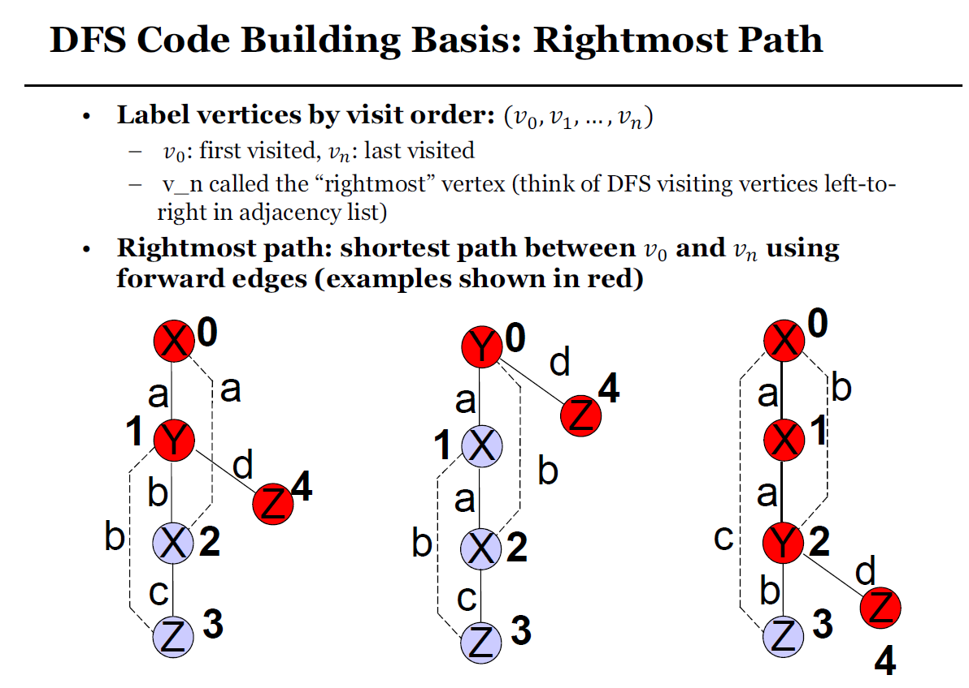

Slide 36
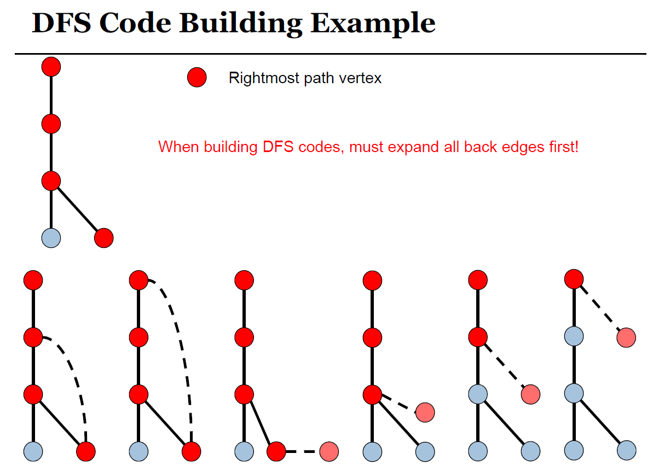
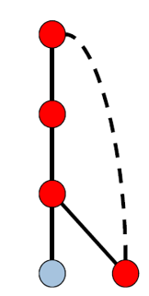
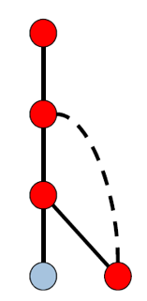

Slide 37
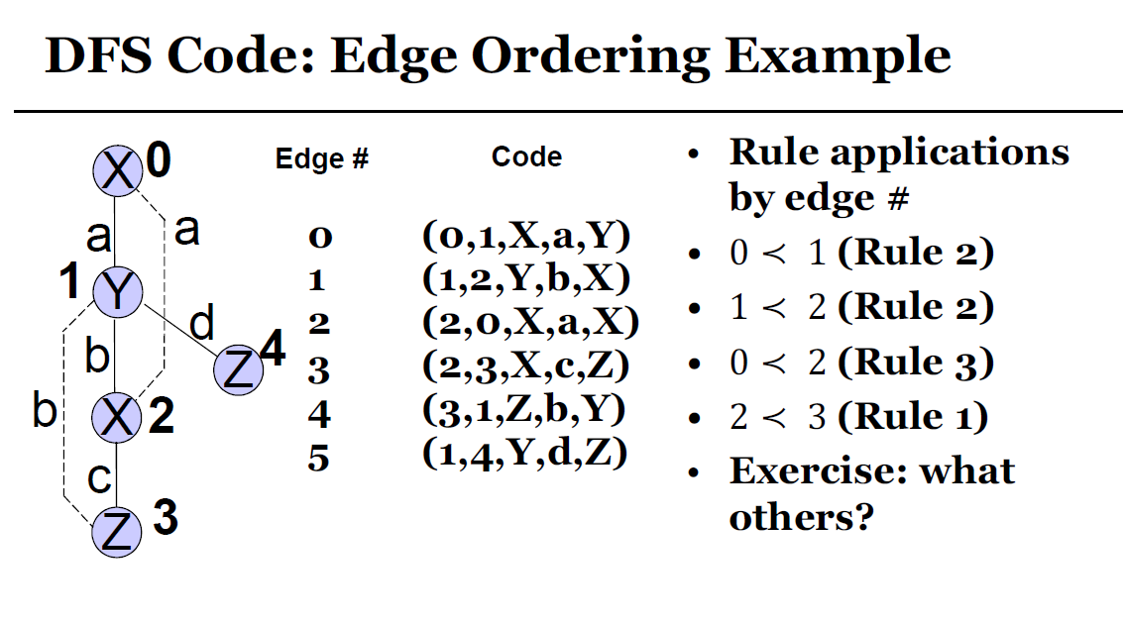

Slide 38
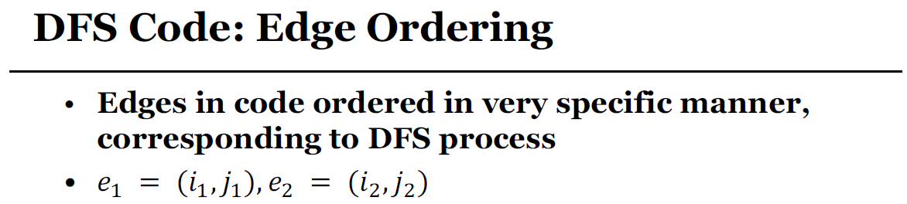
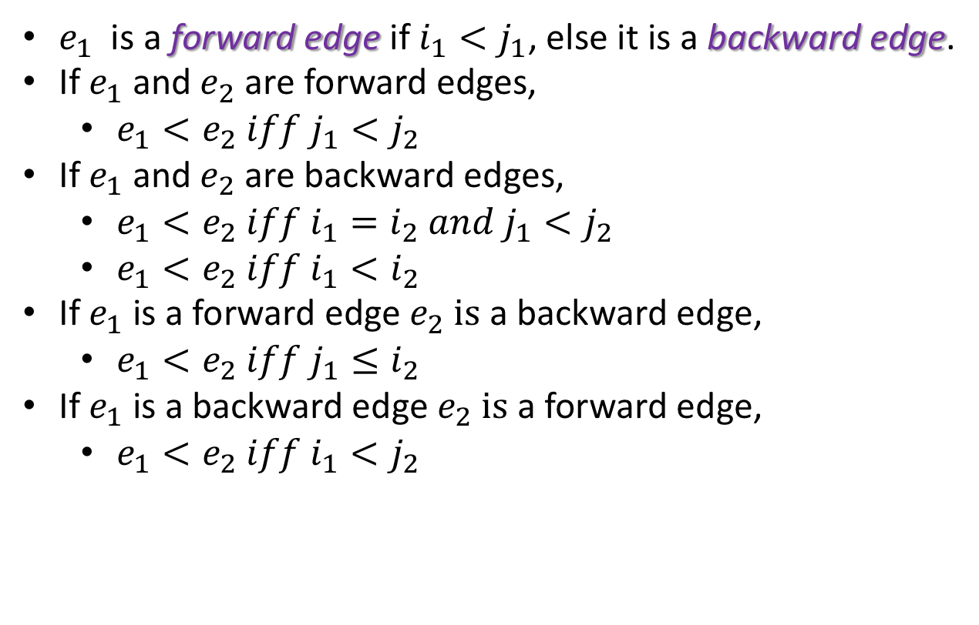
$e_{1}$ is a forward edge if $i_{1}<j_{1}$, else it is a backward edge.
If $e_{1}$ and $e_{2}$ are forward edges,
$e_{1}<e_{2} iff j_{1}<j_{2}$
If $e_{1}$ and $e_{2}$ are backward edges,
$e_{1}<e_{2} iff i_{1}=i_{2} and j_{1}<j_{2}$
$e_{1}<e_{2} iff i_{1}<i_{2}$
If $e_{1}$ is a forward edge $e_{2} is$ a backward edge,
$e_{1}<e_{2} iff j_{1}≤i_{2}$
If $e_{1}$ is a backward edge $e_{2} is$ a forward edge,
$e_{1}<e_{2} iff i_{1}<j_{2}$

Slide 39
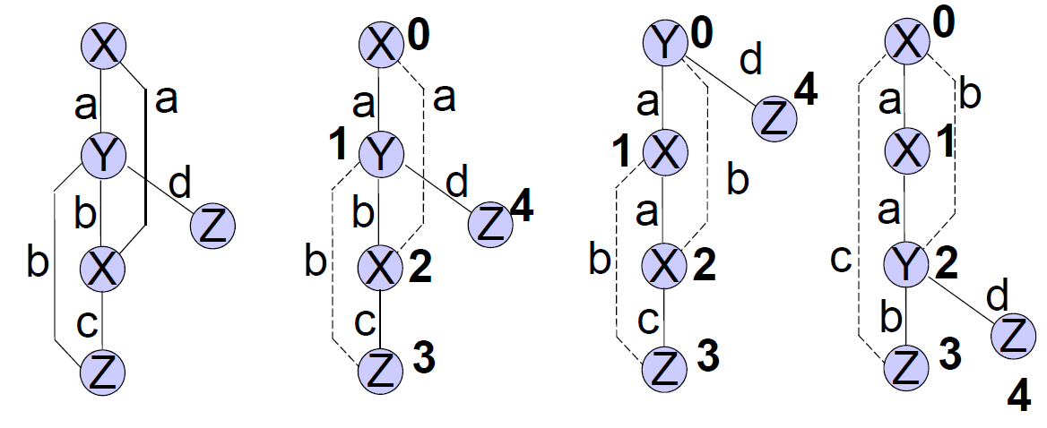
Graphs can have multiple DFS codes!

Slide 40
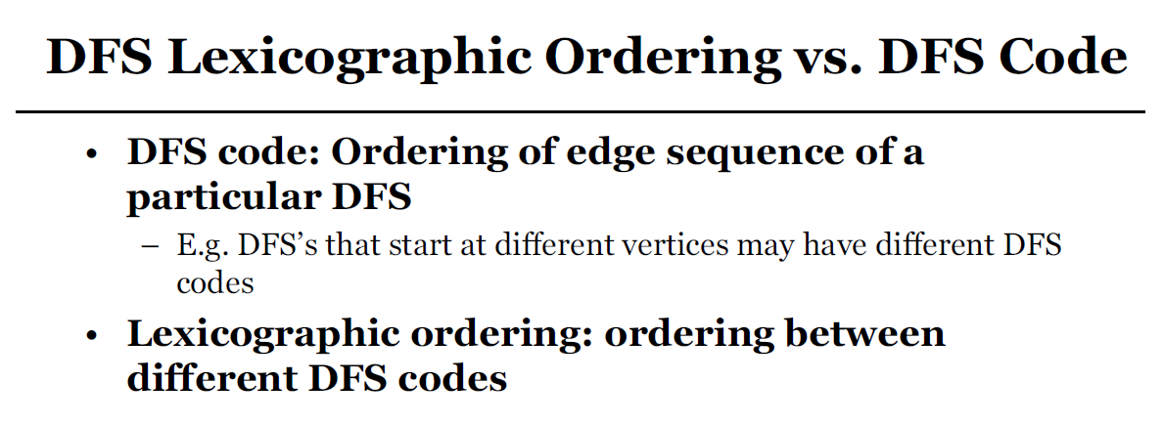

Slide 41
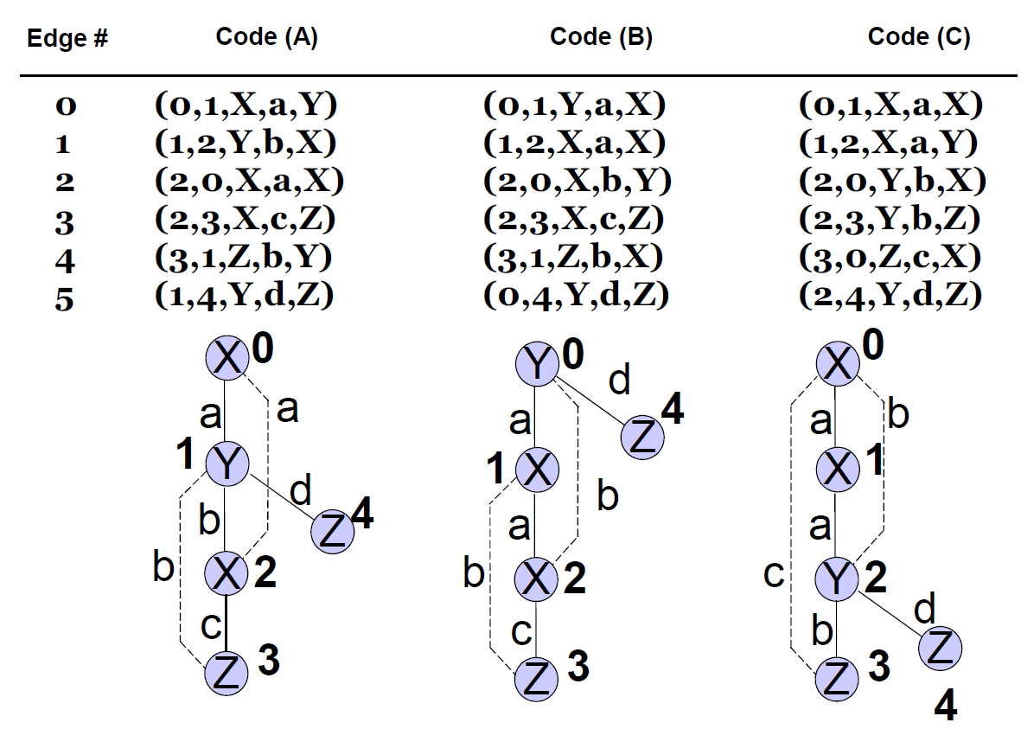

Slide 42
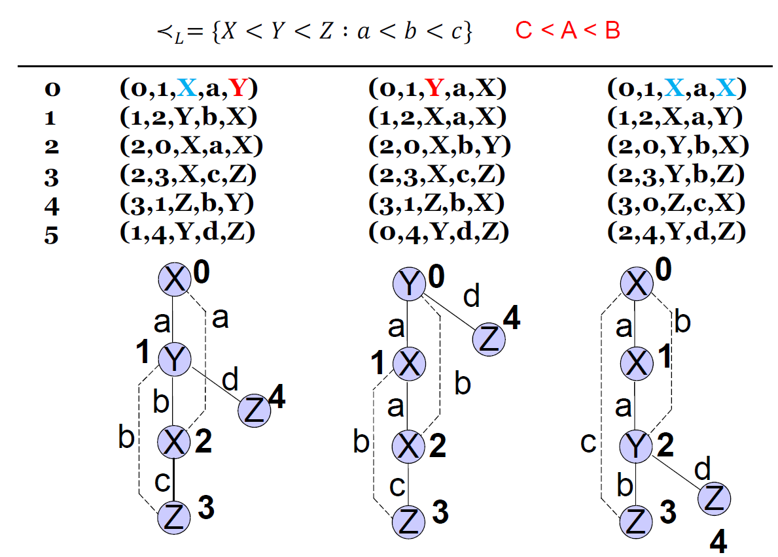

Slide 43
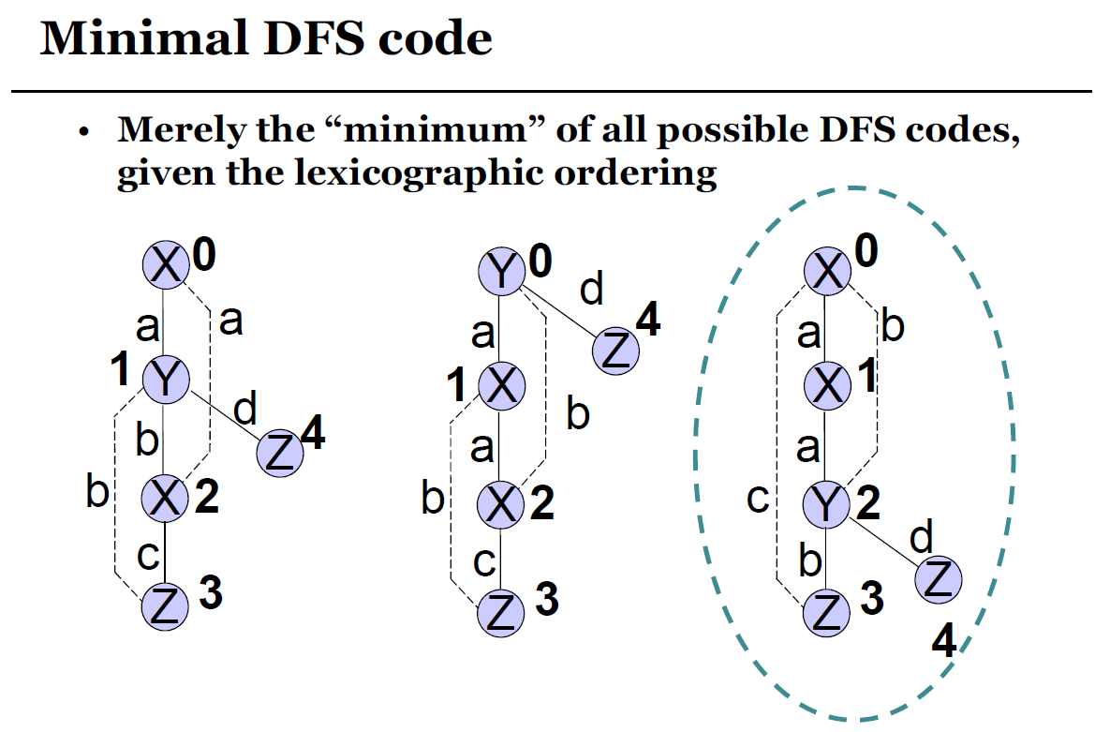

Slide 44
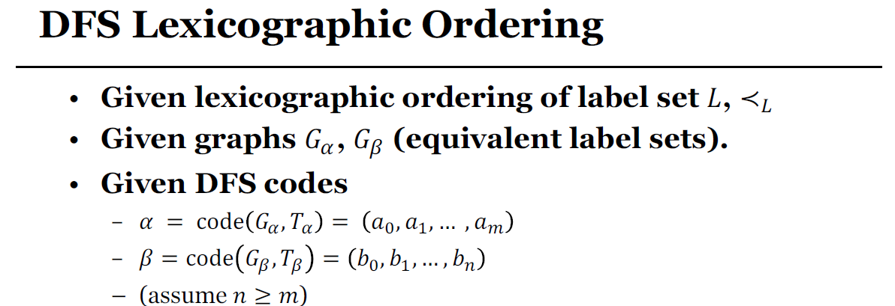
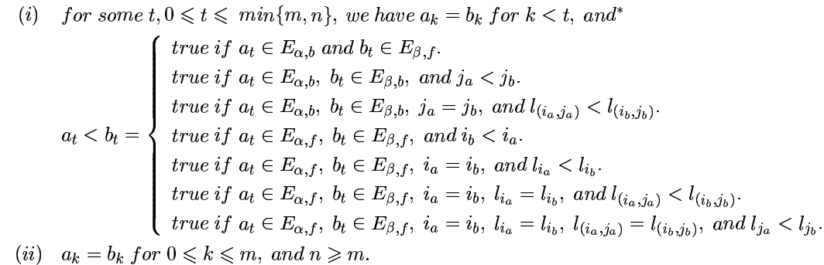
Use lexicographical ordering to break ties, i.e., $i_{1}=i_{1}, j_{1}=j_{2}$

Slide 45
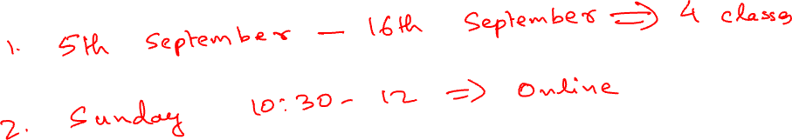
Announcements

Slide 46
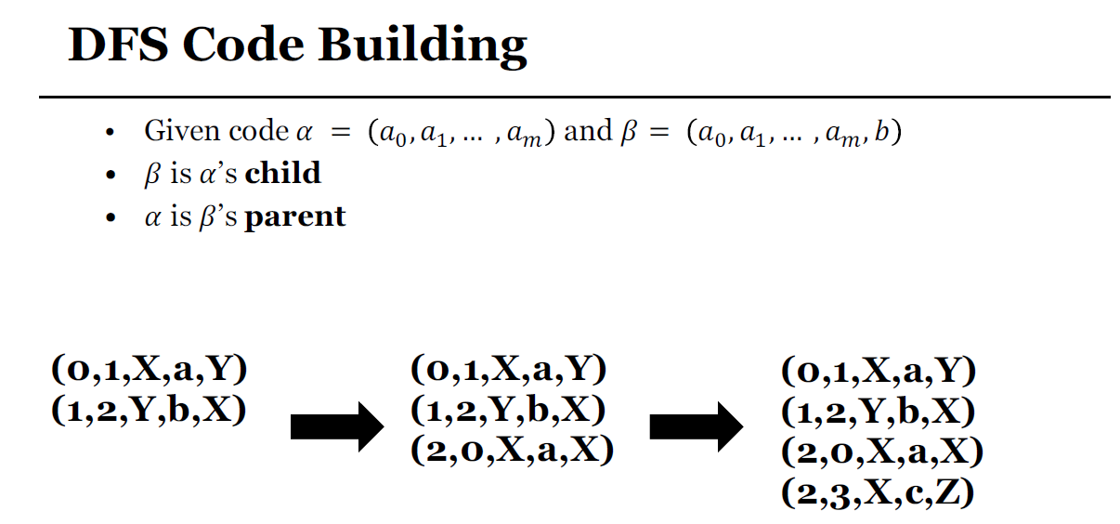


Slide 47
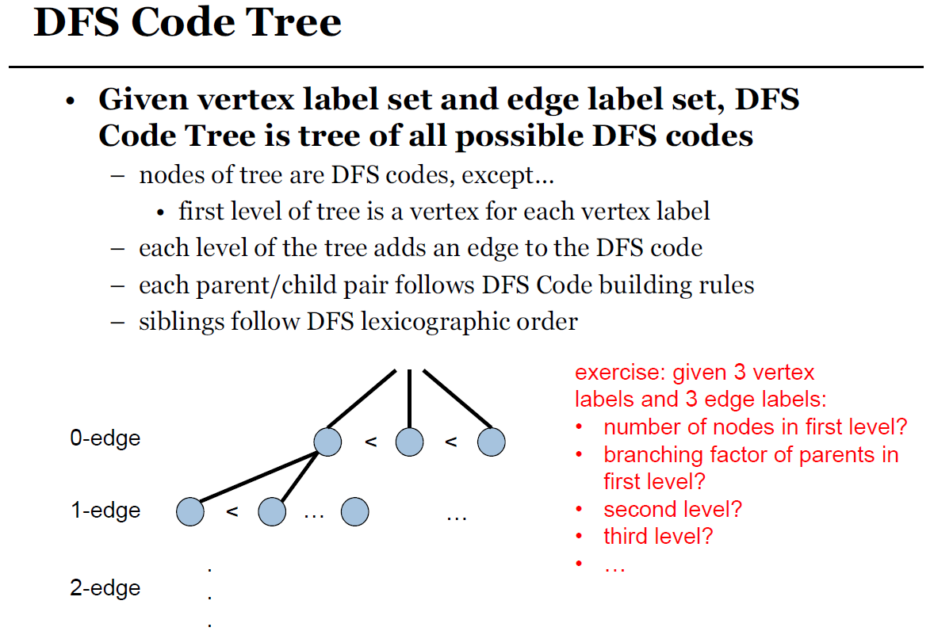
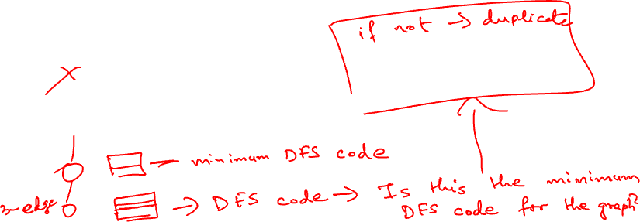

Slide 48
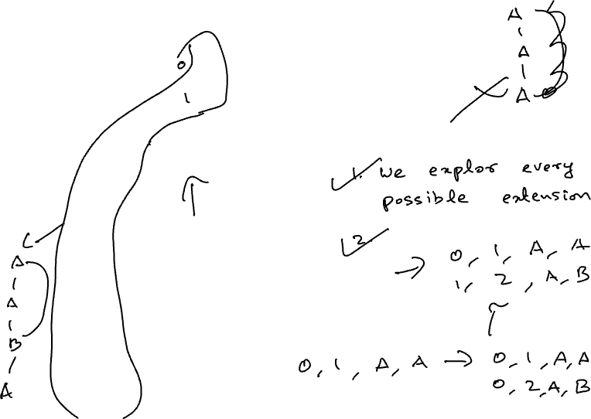

Slide 49
Proof sketch
Any graph has a minimum DFS code
In the tree, we explore all possible DFS codes of all frequent subgraphs
DFS codes are generated in ascending order.
Even if a DFS code is not minimal, there exists a corresponding subgraph
This subgraph is not going to be generated later since any subsequent DFS codes for this graph would not be minimal either (From 3)
Combining 3, 2 and 1, it must have been discovered already.

Slide 50
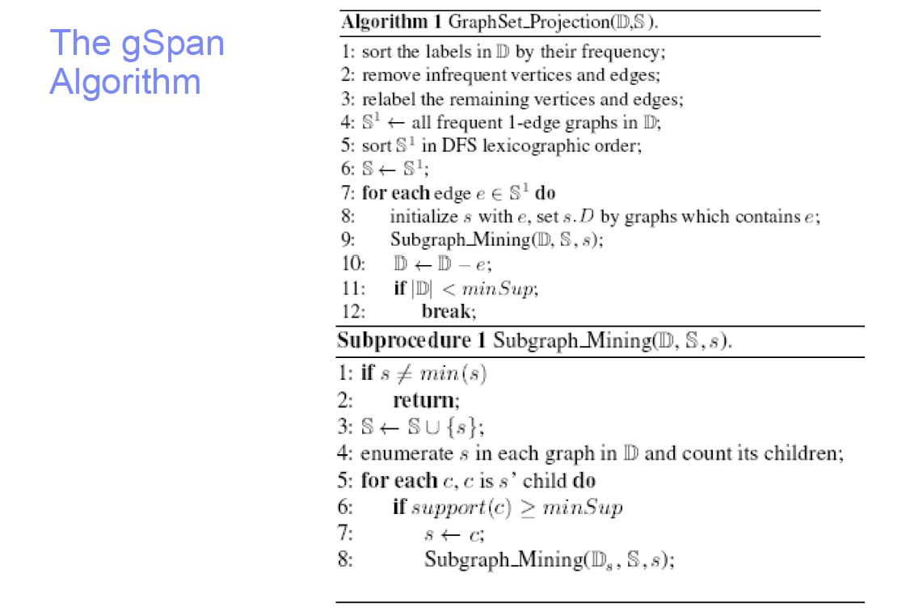
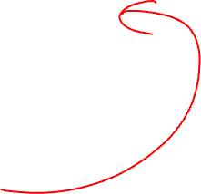

Slide 51
